Slide 1
Diversity and change in Glasgow’s Social and Built Environment
Dr Jonathan Minton
AQMEN Research Fellow
University of Glasgow
Jonathan.Minton@Glasgow.ac.uk

Slide 2
Some caveats/warnings
I tend to work from data to theory
I won’t try to ‘prove’ anything
And I will speculate.

Slide 3
Presentation Structure
Background
History of Greater Glasgow (GG)
Recent change in GG, rest of Scotland, rest of the UK
Theories
Urbanisation and suburbanisation
Network effects and functional geographies
Relationship between the physical, the social, and the economic
Methods
Diversity as entropy
Data and variables used
Definition of Greater Glasgow
Analyses performed
Results
Glasgow in Scottish context
Diversities within Glasgow
Discussion
Initial interpretations
Limitations
Further analyses

Slide 4
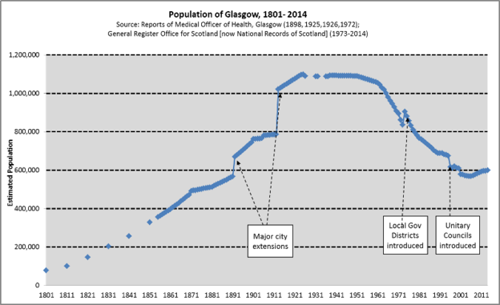
Background – History of Greater Glasgow
http://www.understandingglasgow.com/indicators/population/trends/historic_population_trend
https://en.wikipedia.org/wiki/Demography_of_Scotland

Slide 5
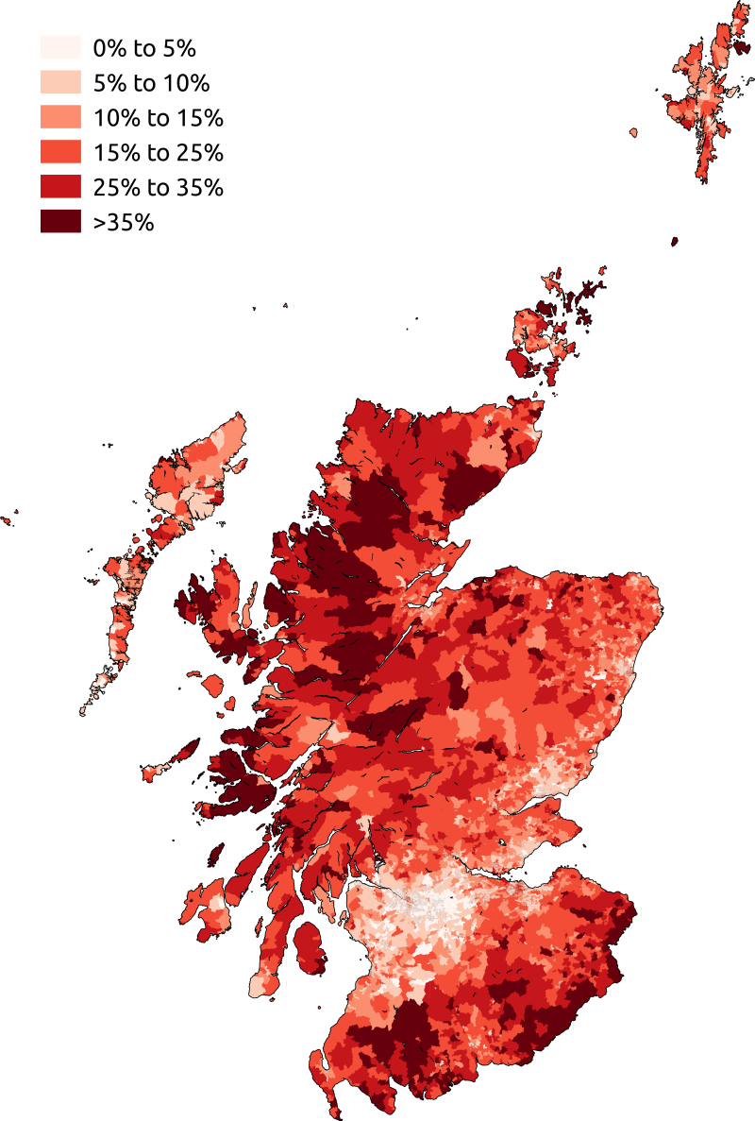
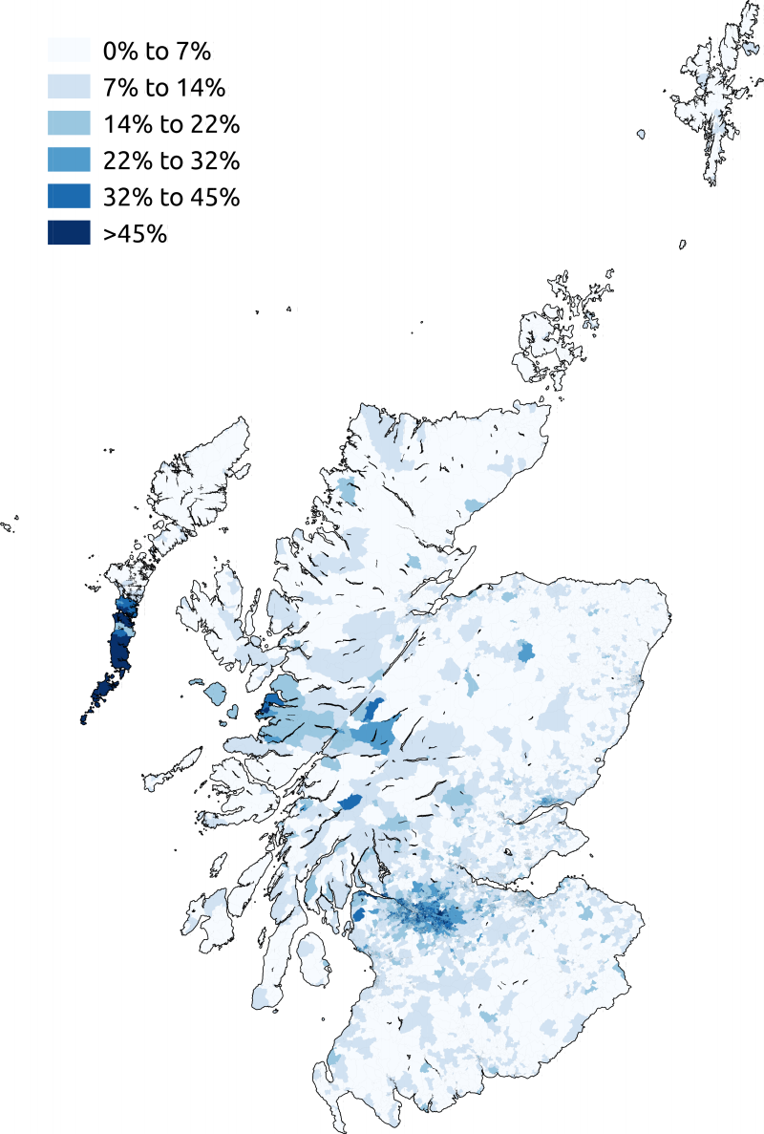
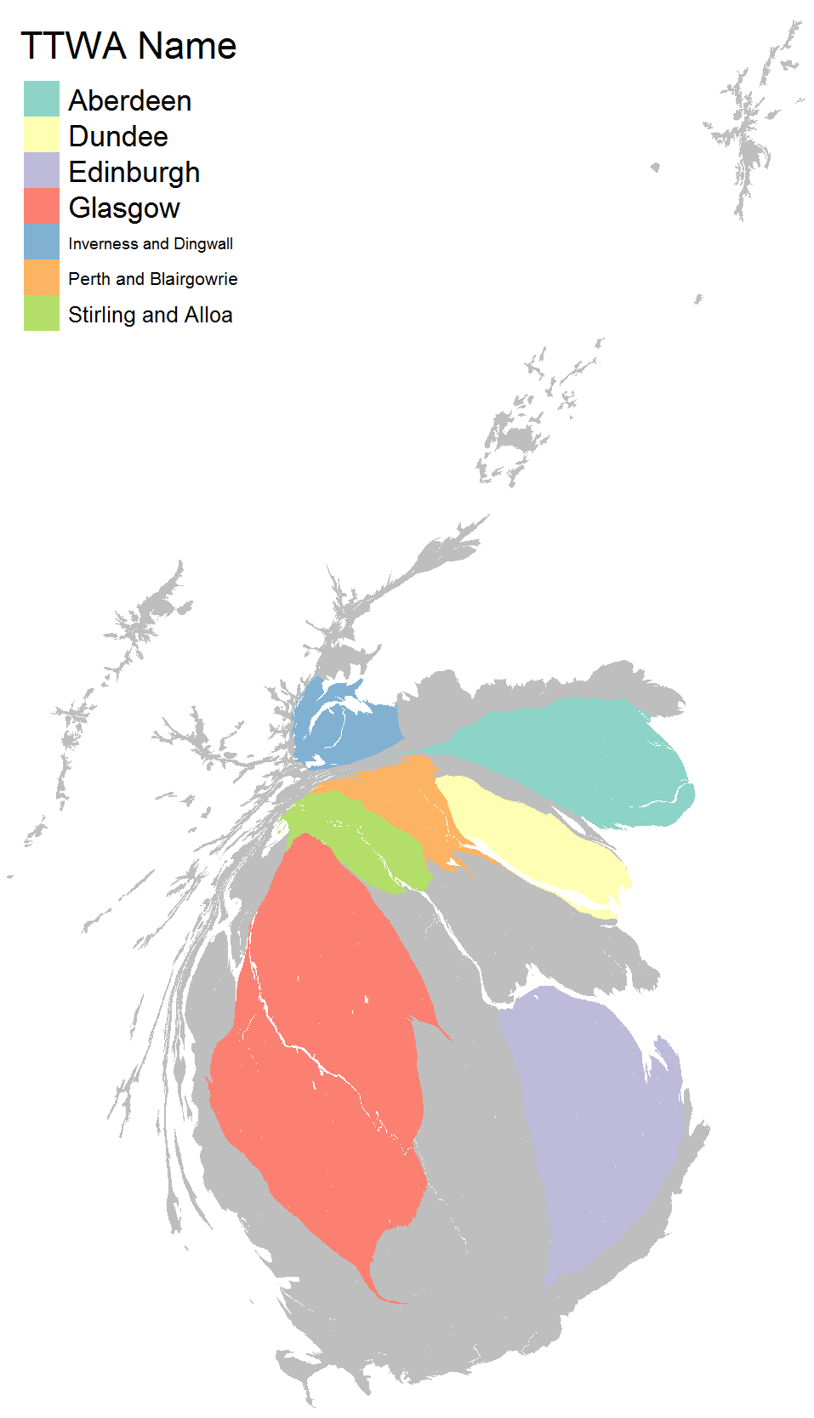
Background – Recent change in GG, rest of Scotland, rest of the UK
English
Born
Roman
Catholic
https://en.wikipedia.org/wiki/Demography_of_Scotland

Slide 7
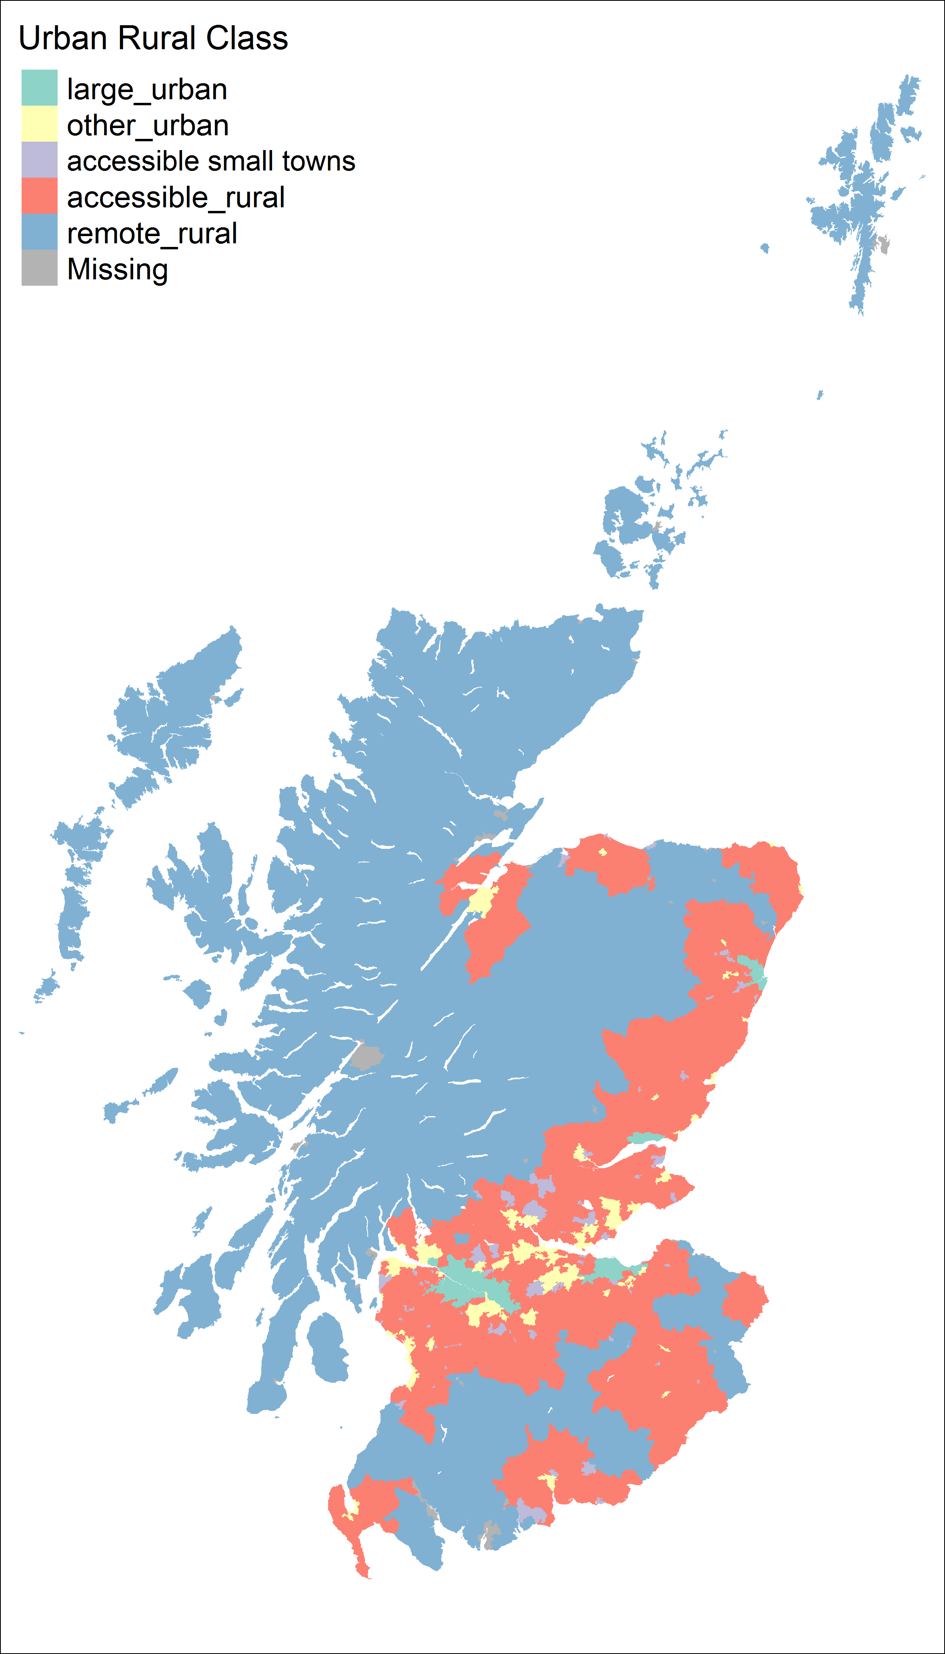
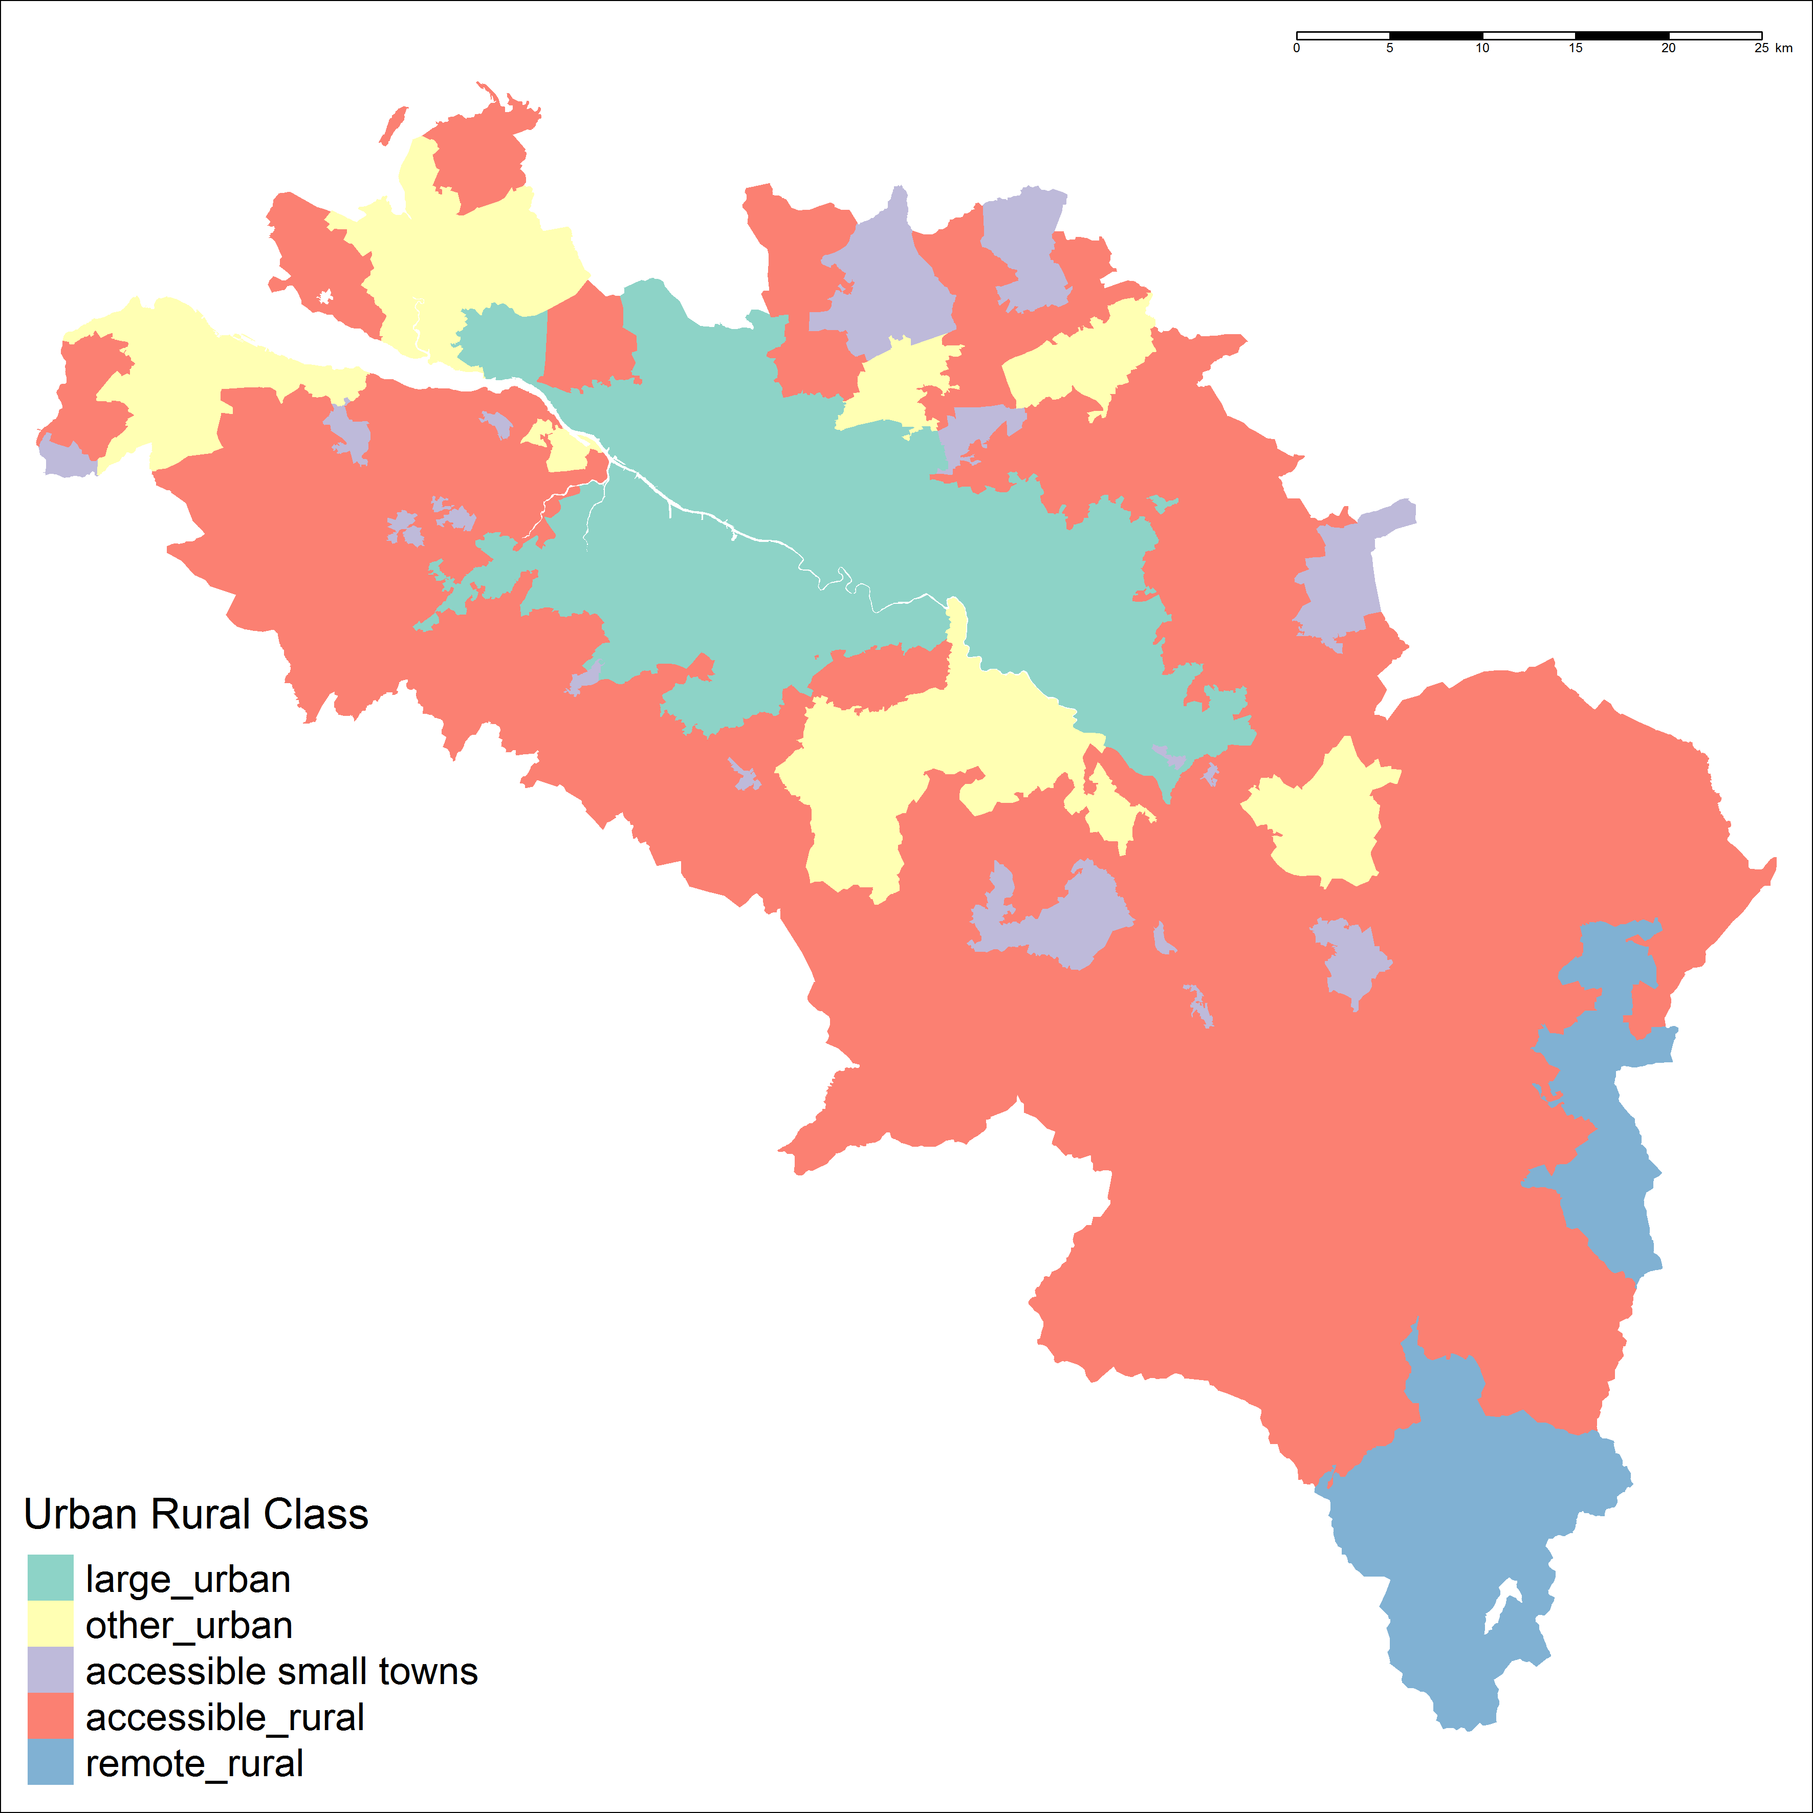
Theories – urbanisation and suburbanisation

Slide 8
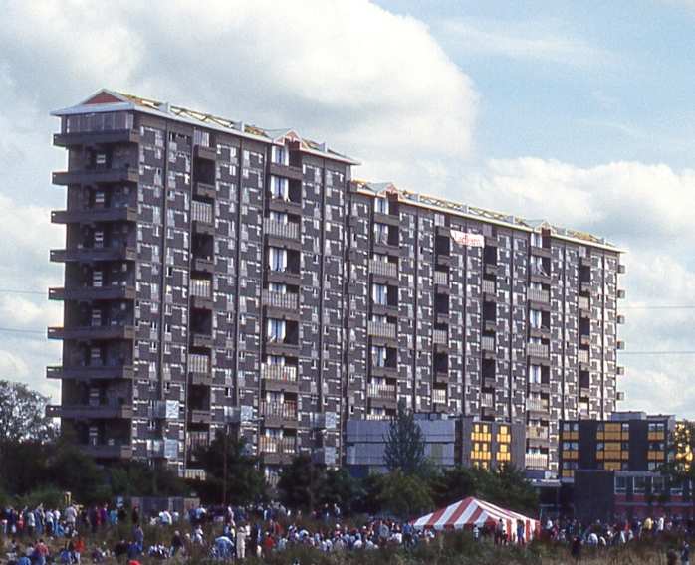
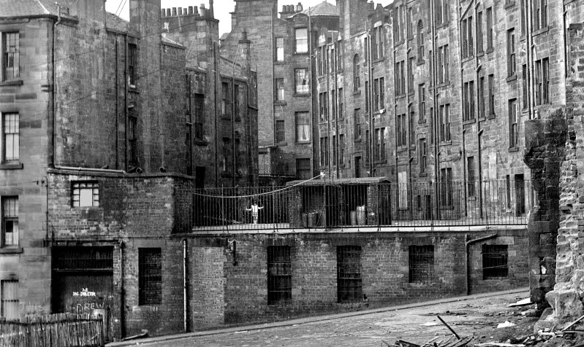
Theories – Housing and urban design
https://en.wikipedia.org/wiki/Hutchesontown_C
http://urbanglasgow.co.uk/archive/glasgow-in-the-1970s-clyde-to-townhead__o_t__t_1281.html

Slide 9
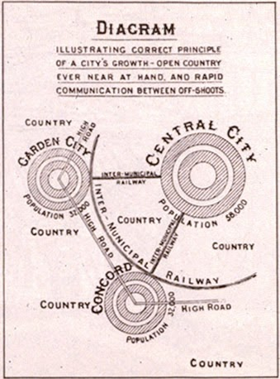
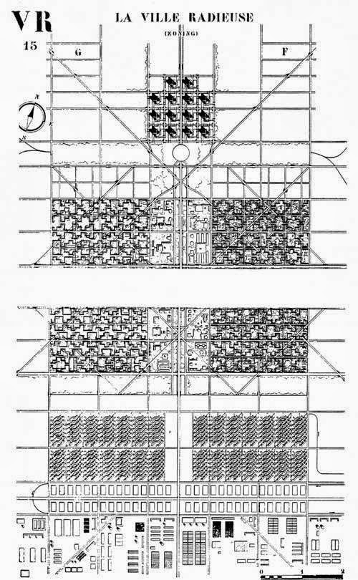
Theories – Housing and urban design
http://carissaevd-urbandesstudies.blogspot.co.uk/2013/10/history-of-urban-design-and-urban.html

Slide 10
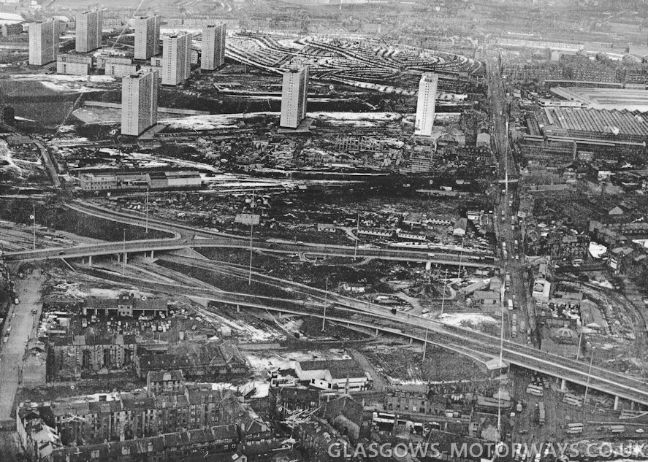
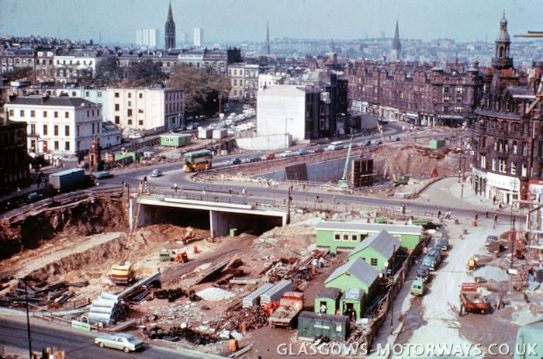
Theories – Housing and urban design
http://www.glasgows-motorways.co.uk/timeline/4591549029
http://www.glasgows-motorways.co.uk/the-m8-motorway/4588285335

Slide 11
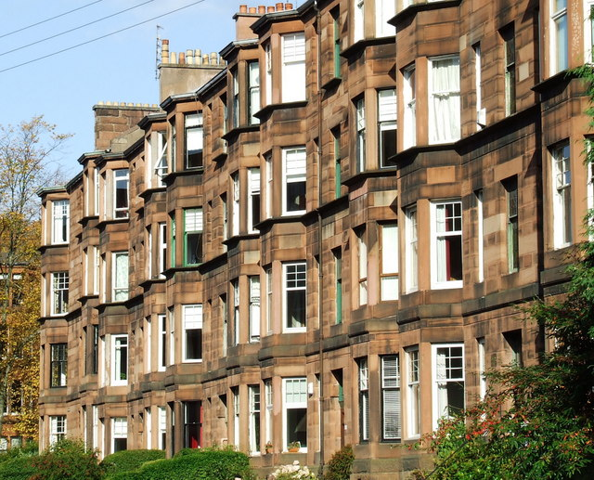
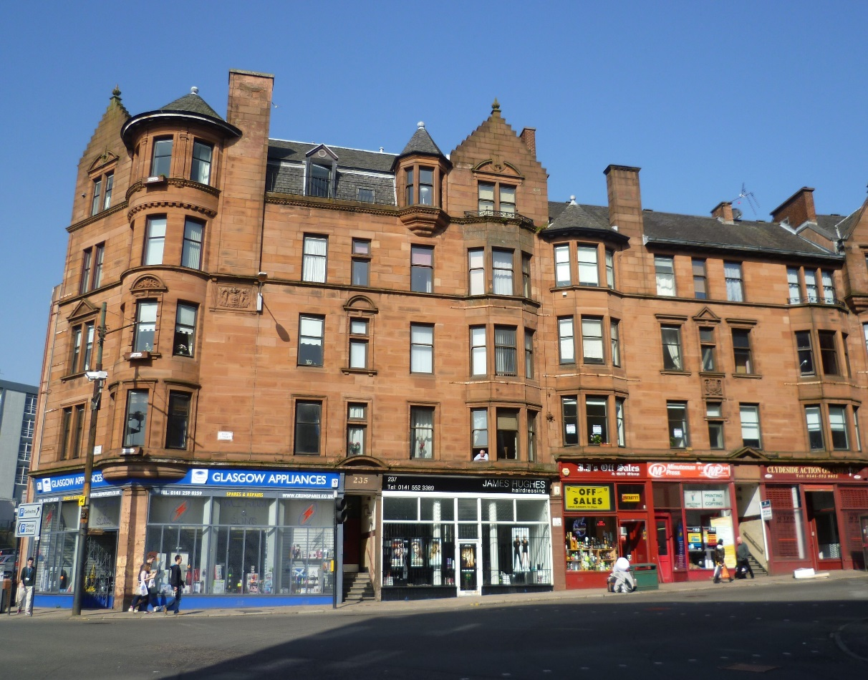
Theories – Housing and Urban Design
https://en.wikipedia.org/wiki/Housing_in_Glasgow
https://en.wikipedia.org/wiki/Housing_in_Glasgow
https://en.wikipedia.org/wiki/High_Street,_Glasgow

Slide 13
Theories – Network effects and functional geographies

Slide 14
Theories – Relationship between the physical, the social, and the economic

Slide 15
Methods – Diversity as entropy

Slide 16
Methods – Data and variables used

